Slide 1
Mini Project Presentation
Basics of NLP, GRU and POS tagging using GRU
Durgesh Kumar Singh(SC18M002)
M.Tech in Machine Learning & Computing
Dept. of Mathematics

Slide 2
Presentation Agenda
PART I:
Basic Natural Language Processing
Basic Text Processing
Language Modelling
Spelling Correction
Text Classification
Sentiment Analysis
POS Tagging
Parsing
Information Retrieval
Semantics
Question Answering
PART II:
NLP Algorithm
Introduction to GRU
PART III:
Problem statement
POS tagging using GRU

Slide 3
PART I:Basic Natural Language Processing
Language Modelling

Slide 4
Language Models
Language Models are used in Machine Translation, Spell Correction, Speech Recognition, Summarization and Question Answering
Language Model computes:
Compute the probability of a sentence or sequence of words: P(W) = P(w1,w2,w3,w4,w5…wn)
Related task: probability of an upcoming word: P(w5|w1,w2,w3,w4)
We can use conditional probability to compute joint probability of sequence of words in sentence:
P(“its water is so transparent”) =
P(its) × P(water|its) × P(is|its water) × P(so|its water is) × P(transparent|its water is so)

Slide 5
How to estimate these probabilities
Could we just count and divide?
Too many possible sentences to compute
Solution is Markov Assumption

Slide 6
N-gram models
We can create N-gram models by taking assumption for Nth-order Markov assumption
We can make unigram, bigram, trigram, 4-grams, 5-grams model by taking N=0,1,2,3,4
In general this is an insufficient model of language
because language has long-distance dependencies:
“The computer which I had just put into the machine room on the fifth floor crashed.”
But we can often get away with N-gram models

Slide 7

Estimating bigram probabilities
The Maximum Likelihood Estimate
<s> I am Sam </s>
<s> Sam I am </s>
<s> I do not like green eggs and ham </s>

Slide 8
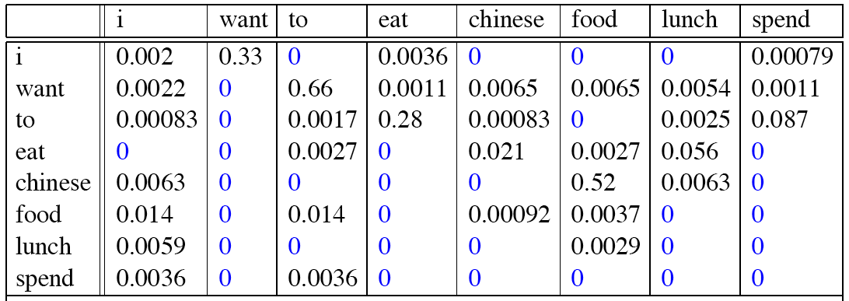
Raw bigram probabilities on Berkeley Restaurant Project sentences

Slide 9
Evaluation: How good is our model?
Does our language model prefer good sentences to bad ones?
Assign higher probability to “real” or “frequently observed” sentences
Than “ungrammatical” or “rarely observed” sentences?
We train parameters of our model on a training set.
We test the model’s performance on data we haven’t seen.
A test set is an unseen dataset that is different from our training set, totally unused.
An evaluation metric tells us how well our model does on the test set.
Evaluation of the model can be extrinsic or intrinsic

Slide 10
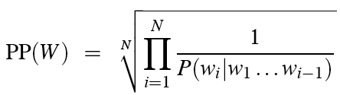
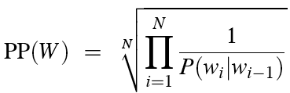
Evaluation of N-gram Models
Extrinsic Evaluation: Compare two models A and B by putting the model in a specific task and get the accuracy of the model
Intrinsic Evaluation: use perplexity measure
Perplexity is the inverse probability of the test set, normalized by the number of words:
Chain rule:
For bigrams:

Slide 11
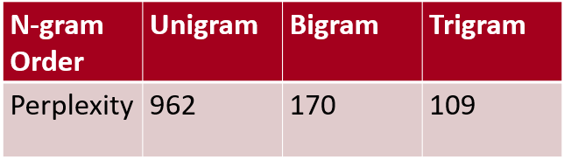
Lower perplexity = better model
Training 38 million words, test 1.5 million words, WSJ

Slide 12
Practical Issues
We do everything in log space
Avoid underflow
(also adding is faster than multiplying)

Slide 13
Zero probability bigrams
Bigrams with zero probability
mean that we will assign 0 probability to the test set!
And hence we cannot compute perplexity (can’t divide by 0)!
Example
Training set:
… denied the allegations
… denied the reports
… denied the claims
… denied the request
Test set
… denied the offer
… denied the loan
P(“offer” | denied the) = 0

Slide 14
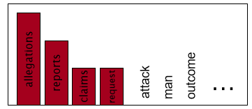
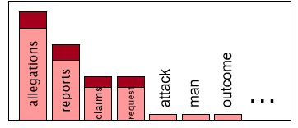
Laplace Smoothening
When we have sparse statistics:
Steal probability mass to generalize better
P(w | denied the)
3 allegations
2 reports
1 claims
1 request
7 total
P(w | denied the)
2.5 allegations
1.5 reports
0.5 claims
0.5 request
2 other
7 total

Slide 15
Back-off and Interpolation
Sometimes it helps to use less context
Condition on less context for contexts you haven’t learned much about
Back-off:
use trigram if you have good evidence,
otherwise bigram, otherwise unigram
Interpolation:
mix unigram, bigram, trigram
Interpolation works better

Slide 16
PART II: NLP Algorithm
Gated Recurrent Unit(GRU)

Slide 17
Introduction to GRU
GRU was introduced in 2014 to solve the vanishing gradient problem which comes with standard RNN
GRU can be considered as variation of LSTM
The LSTM was followed by the Gated Recurrent Unit (GRU) and both have the same goal of tracking long-term dependencies effectively

Slide 18
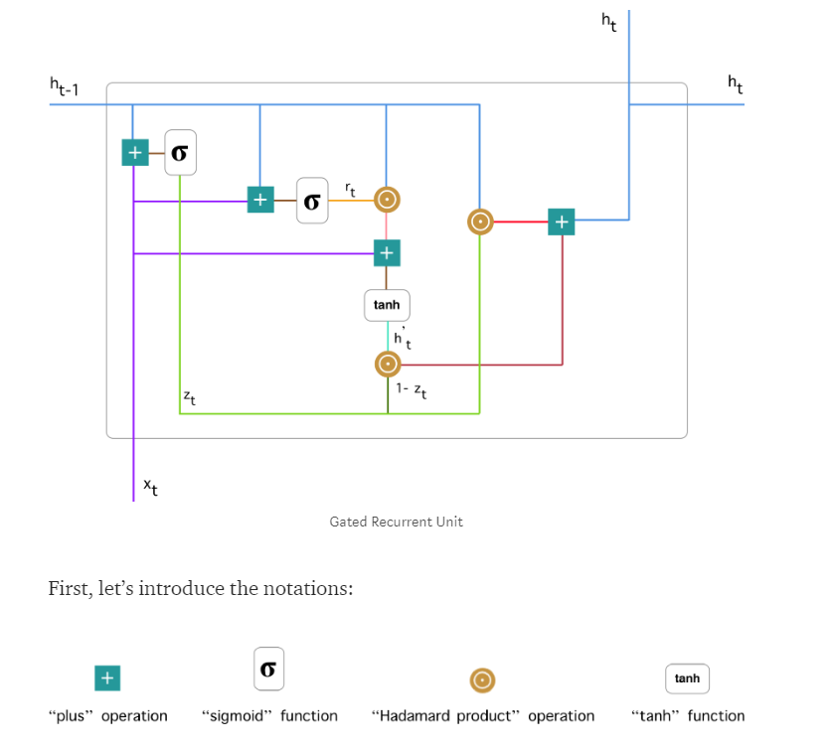
Architecture of GRU Cell

Slide 19

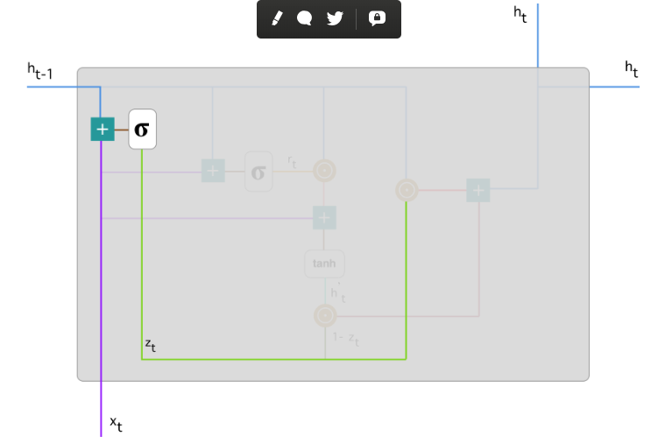
Update Gate
We start with calculating the update gate z_t for time step t using the formula:

Slide 20

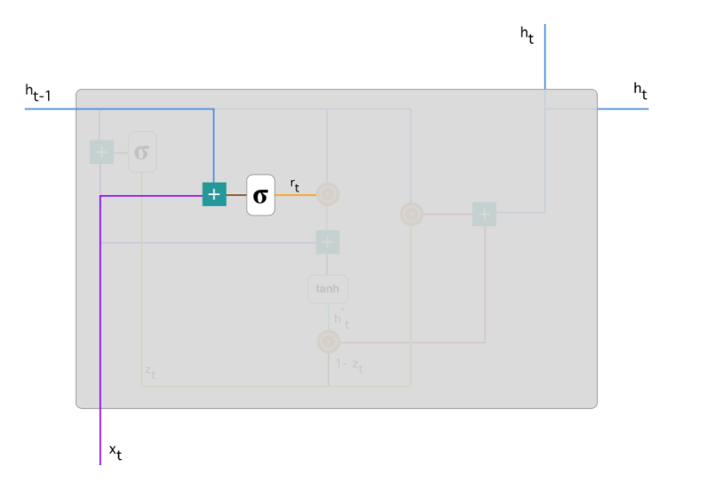
Reset Gate
Essentially, this gate is used from the model to decide how much of the past information to forget. To calculate it, we use:

Slide 21

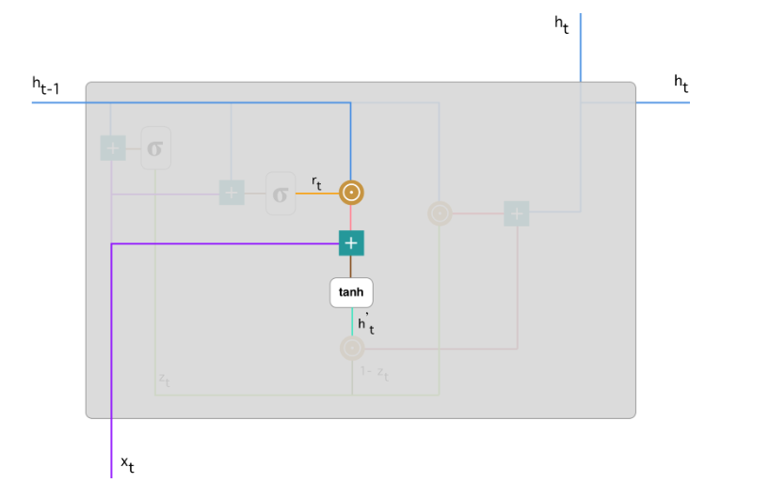
Current memory content
A new memory content which will use the reset gate to store the relevant information from the past. It is calculated as follows:

Slide 22

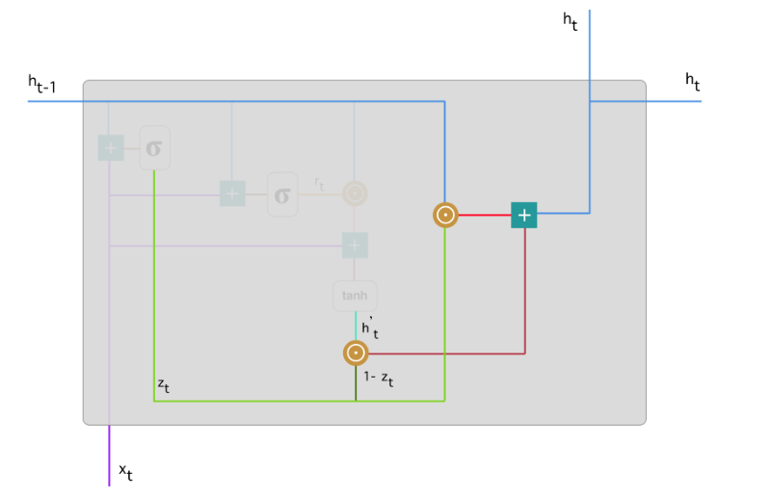
Final memory at current time step
As a last step, the network needs to calculate h_t — vector which holds information for the current unit and passes it down to the network.

Slide 23
PART III: Problem Description
Parts of Speech tagging

Slide 24
POS Tagging using GRU
The purpose of this project was to learn how to implement RNNs and implement GRU architecture for the task of Parts-of-Speech tagging using a part of the CoNLL-2012 dataset with 42 possible tags.
This project includes:
a custom implementation of the GRU cell.
a custom implementation of the RNN architecture that may be configured to be used as an GRU or Vanilla RNN.
a Parts-of-Speech tagger that can be configured to use any of the above custom RNN implementations.

Slide 25
Timeline of the project
Week I - II
Understanding the Parts of Speech tagging problem in detail
Week III -IV
Learning to use pytorch and torchtext
Preprocessing the dataset
Implementation of GRU architecture
Week V - VI
Implementation of POS tagger
Week VII
Project report submission

